Slide 1

Hello World! - The AI Chapter
By Epoch Team, IIT Hyderabad

Slide 2
For those who missed the opportunity orientation
Link to the Slides:
SciTech Orientation 2022 - Epoch
If there are any questions or concerns, we encourage you to contact us after the session.
The contact details can be found in the orientation slides

Slide 3
Today’s Digest!
Check out this Article where AI is used to control crowd and climate in the Football World Cup 2022 @ Qatar this year
In October, more than 130 people were killed in a crowd crush at a football stadium in Indonesia after police fired tear gas at fans who streamed onto the pitch, followed by people running into locked exits while trying to exit the stadium.
The Qatar centre’s technical team says that data aggregation allows them to forecast crowd patterns. Since they know the exact number of people expected based on ticket sales, they can predict crowd surge. That could be based on time of arrival, points of entry or even the movement of people at any given time.

Slide 4
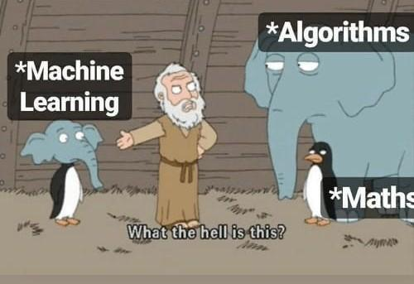
We don’t do definitions, we do memes :)

Slide 5
AI? You know ‘bout this??
Artificial intelligence is the simulation of human intelligence processes by machines, especially computer systems.
Some standard applications of AI are:
Natural Language Processing (NLP)
Computer Vision (CV)
Reinforcement Learning (RL)
Recommender Systems (RS)

Slide 6
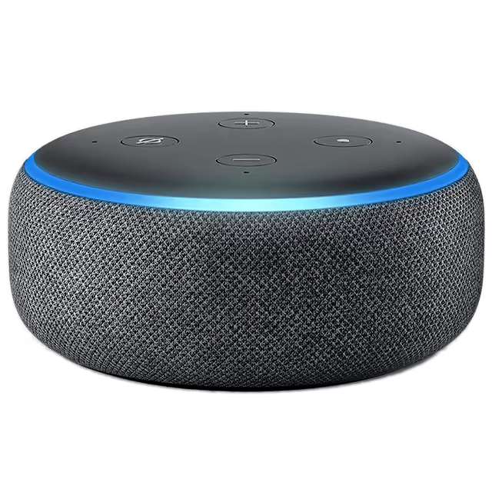
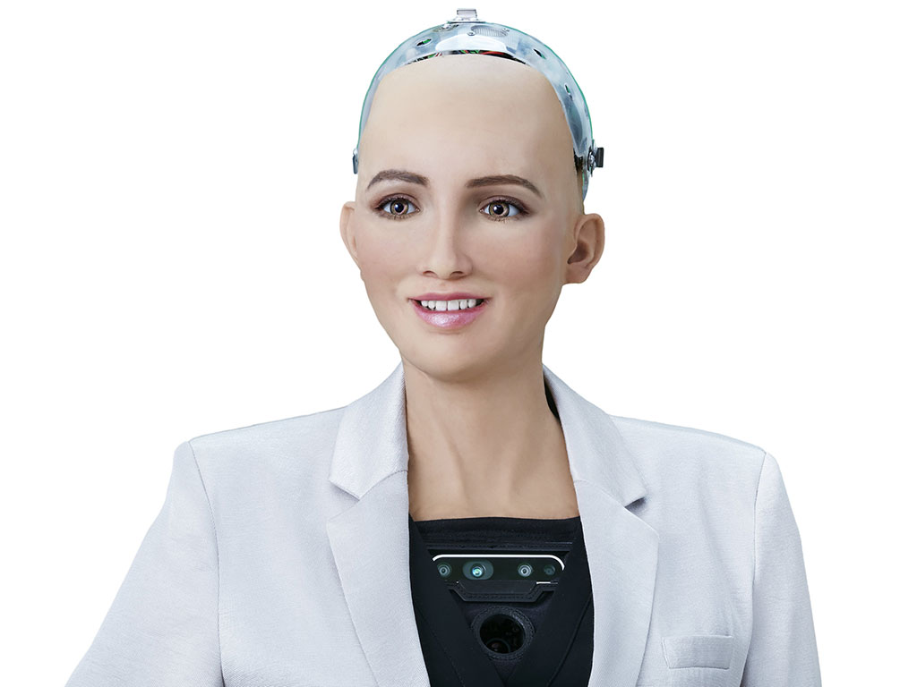
Stages The (only) Stage of AI
Artificial Narrow Intelligence (ANI) [Weak AI]
It is the stage of AI involving machines that can perform only a narrowly defined set of specific tasks. At this stage, the machine does not possess any thinking ability, it just performs a set of pre-defined functions.
Eg: Siri, Alexa, Self-driving cars, Alpha-Go, Sophia the humanoid and so on. Almost all the AI-based systems built till this date fall under the category of Weak AI.
Alexa
Sofia

Slide 7
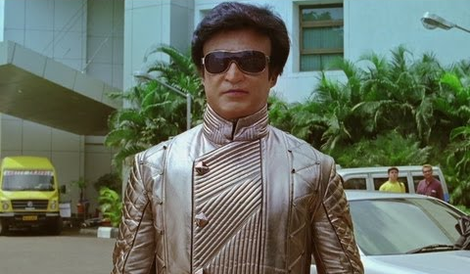
Stages of AI
2. Artificial General Intelligence (AGI) [Strong AI]
It is the stage in the evolution of AI wherein machines will possess the ability to think and make decisions just like us humans. There are currently no existing examples of Strong AI, however, it is believed that we will soon be able to create machines that are as smart as humans.
3. Artificial Super Intelligence (ASI)
It is the stage of AI when the capability of computers will surpass human beings. ASI is currently a hypothetical situation as depicted in movies and science fiction books, where machines have taken over the world.
Chitti

Slide 8
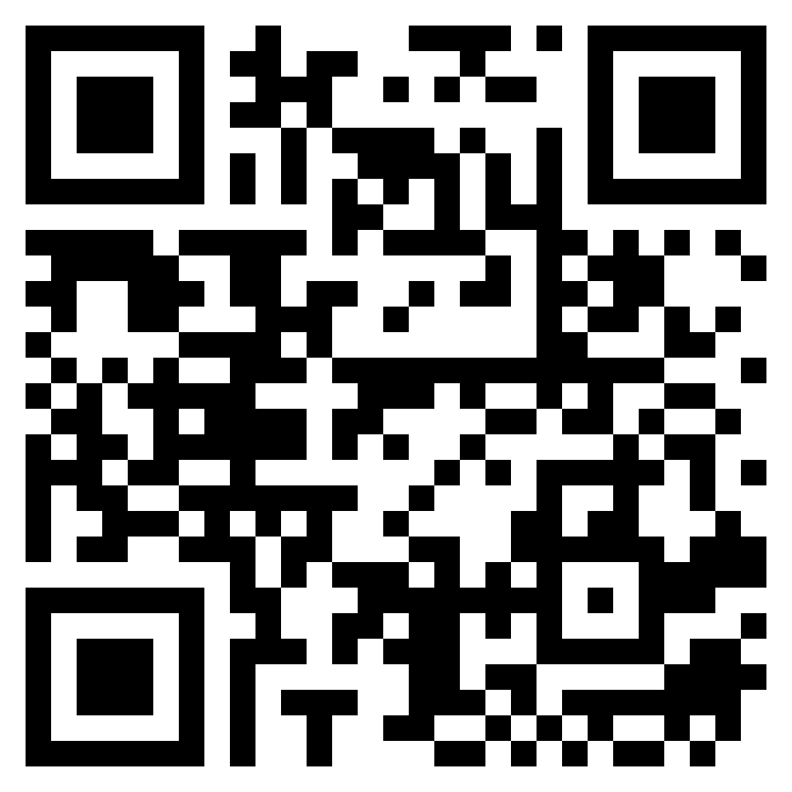
Fastest Fingers First - Kaun Banega Crorepati?
Scan the QR code
Submit your answers in the Google Form
The fastest one gets….

Slide 9
LMNoooooo….It is ML!
Grand Goal of ML: Mimicking human Learning is ML
To develop computer programs that can mimic high-level cognitive abilities in humans for solving complex problems (e.g., those in Astrophysics, Biology, Environment etc.)
Machine learning is a branch of artificial intelligence (AI) and computer science which focuses on the use of data and algorithms to imitate the way that humans learn, gradually improving its accuracy.
“Machine Learning is the study of computer algorithms that improve automatically through experience.” - Tom Mitchell

Slide 10

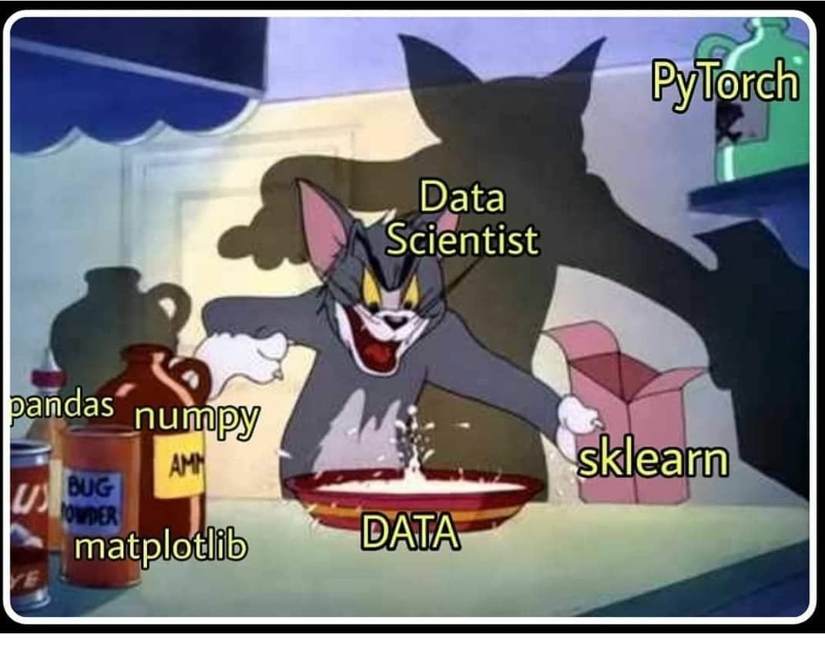
Data Science = Statistics? Definitely n0t!
Data science is the field of applying advanced analytics techniques and scientific principles to extract valuable information from data for business, decision-making, strategic planning and other uses.

Slide 11
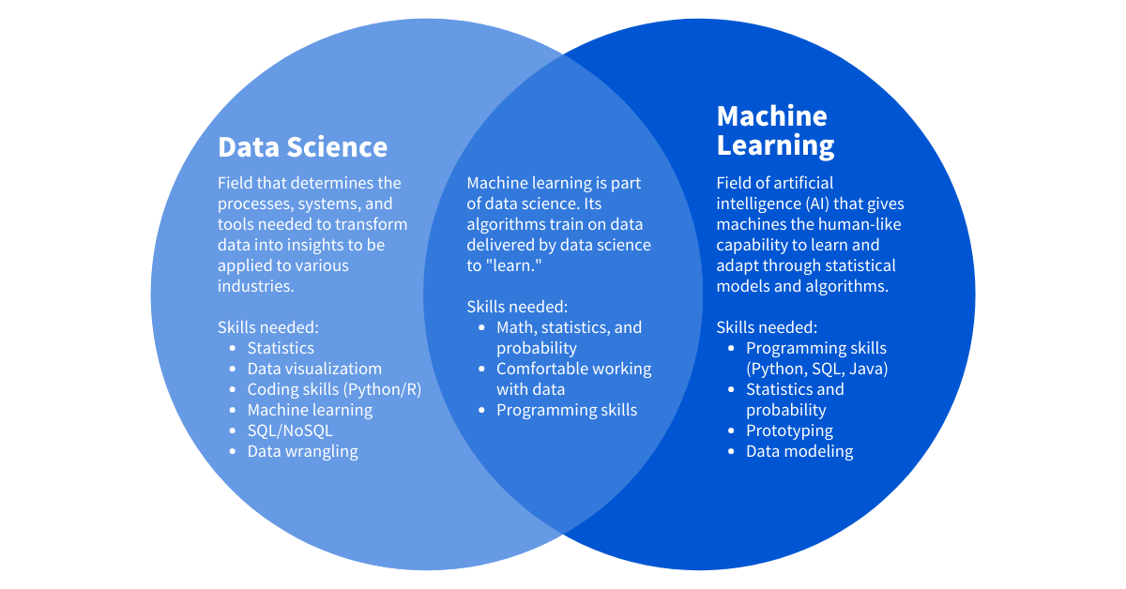

Slide 12



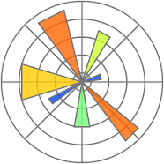

Tools (or) Libraries at hand - Next Session Topic…shhhhh
Numpy - to work with arrays and vectors
Pandas - to work with the dataset (.csv files)
Matplotlib & Seaborn - for visualization
Tensorflow - to create deep learning models

Slide 13





Slide 14
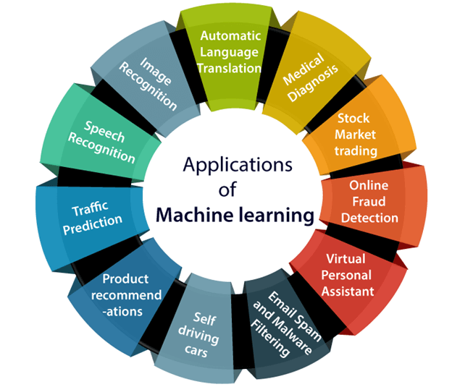
Real-world Applications
Image Recognition - Google lens
Medical Diagnostics - Medical image processing
Stock Market - Stock price prediction
Content Personalization - Netflix, Spotify, Youtube
Traffic Prediction - Google Maps
Speech Recognition - Virtual assistant like Alexa

Slide 15
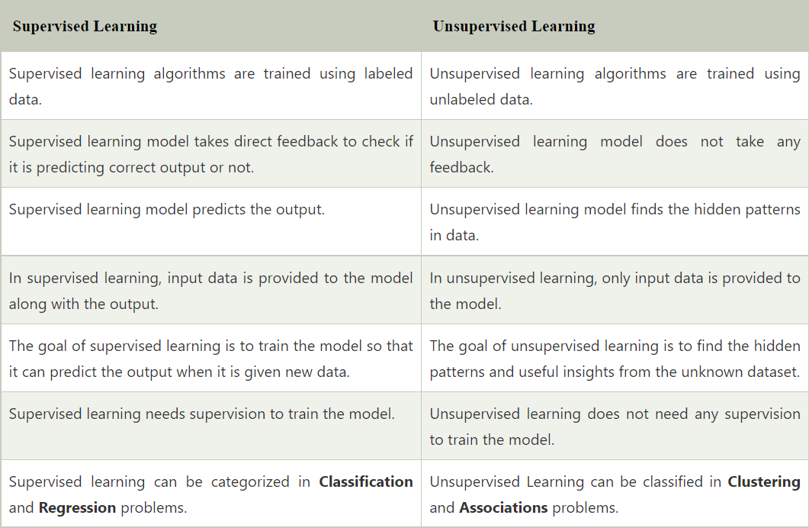
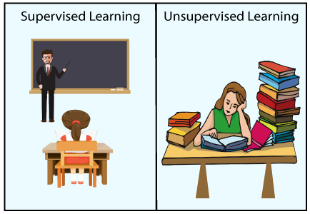
Types of ML [ Lectur-ish slide :( ]

Slide 16

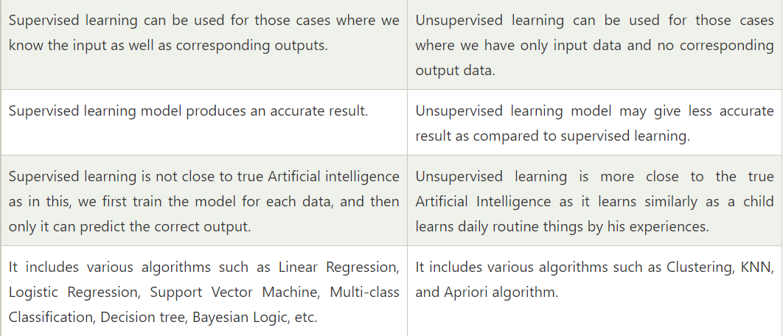
Are we doing Supervised Learning now?

Slide 17
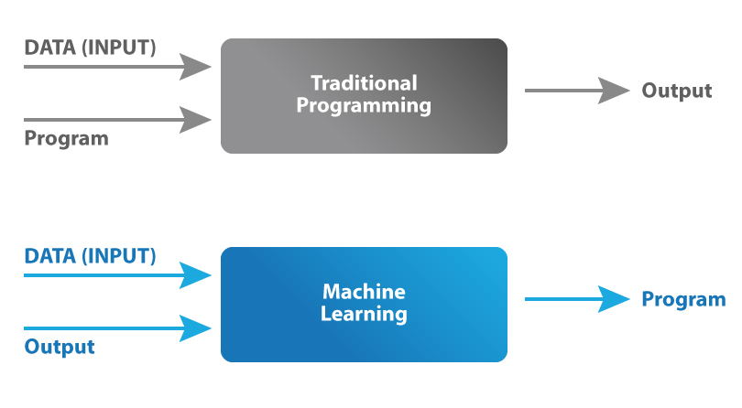
Model learns, but IITians don’t? Nah, we learn ML Models
Setting aside the mathematical jargon, a supervised model basically learns a function that maps the inputs X to the outputs Y.
In supervised learning, we give the model a certain set of parameters, that it continuously tune, so that it can learn an appropriate function that does well on the input dataset.

Slide 18

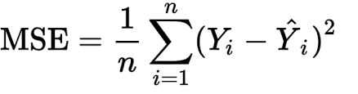
Loss function (or) Cost Function
Loss function predicts the deviation of the predicted outcome from the actual result. It measures how well the machine learning algorithm models the training dataset.
We convert the machine learning problem into an optimization problem, by defining the loss function and then gradually optimizing the algorithm so that the loss function is minimized.
One of the common loss functions is MSE
(Mean Squared Error).

Slide 19
Clarification Needed? Yes!
We usually consider both terms - cost function and loss function as synonyms and think we can use them interchangeably.
But, the Loss function is associated with every training example, and the cost function is the average of the loss function values over all the data samples.
In Machine learning, we usually try to optimize our cost function rather than our loss function.

Slide 20
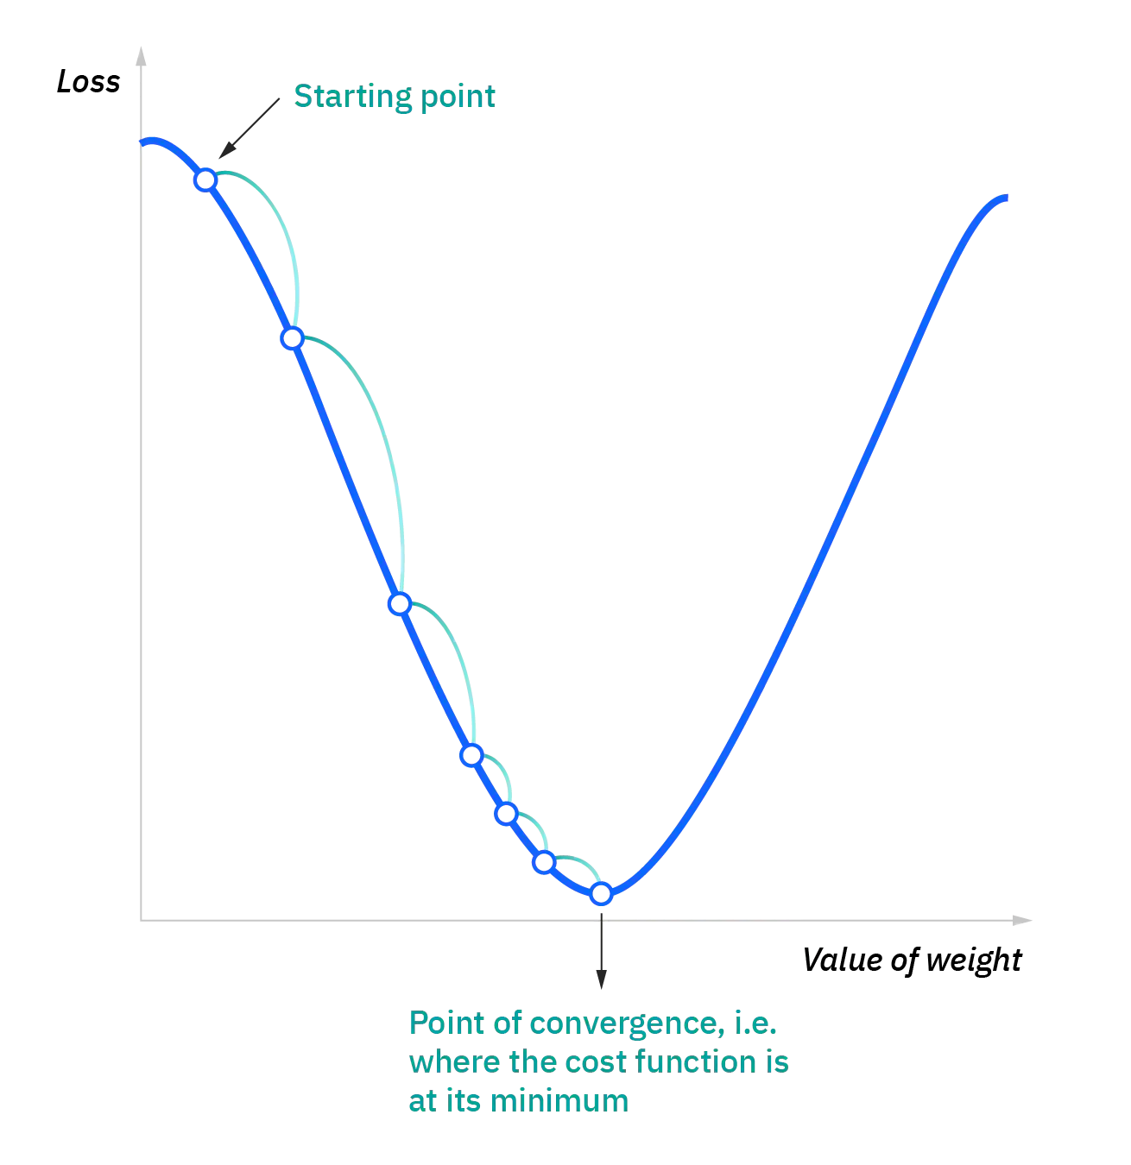
Now, what is gradient descent…
Gradient descent is an optimization algorithm/technique
commonly used to train machine learning models.
The key idea behind this algorithm is to take the fastest route
towards the minimum of the function from current point to
converge fast.
So, we take repeated steps in the opposite direction of the
gradient of the function as that is the steepest descent possible.

Slide 21
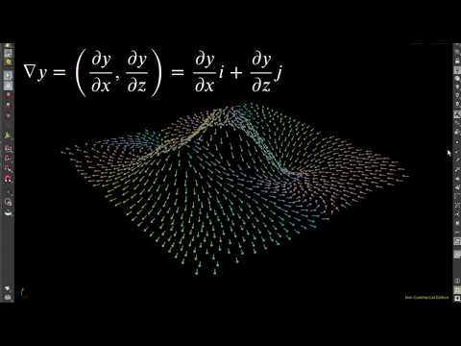
Gradient Descent Visualization

Slide 22
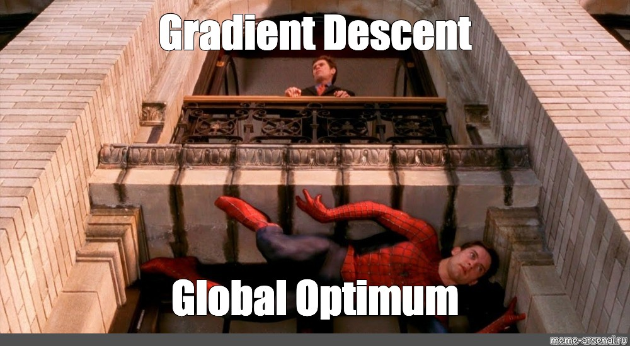

Slide 23
Computer Vision - 101
No, it’s not about the webcam.
Computer vision is a field of artificial intelligence (AI) that enables computers and systems to derive meaningful information from digital images, videos and other visual inputs — and take actions or make recommendations based on that information.

Slide 24
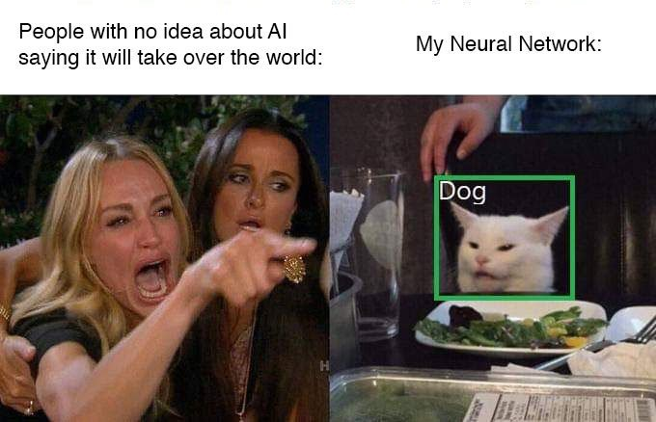

Slide 25
Classification - The Holy Grail
One of the first tasks that was tackled “Computer Vision” involved simple Classification of Hand-written digits.
Later on (after a lot of effort) the ImageNet dataset was created and it was being used for benchmarking models. There were many models working on it , each achieving only 40 -50 % accuracies at best.
During 2012, Alex Krizhevsky invented the AlexNet (You may call this the advent of the real “Deep learning”, it smashed the competition by nearly 10.8 % difference in the top-5 error rate.)

Slide 26
What Do We Actually Do?
There are many visual recognition problems that are related to image classification, such as object detection, image captioning, semantic segmentation, visual question answering, visual instruction navigation, scene graph generation

Slide 27
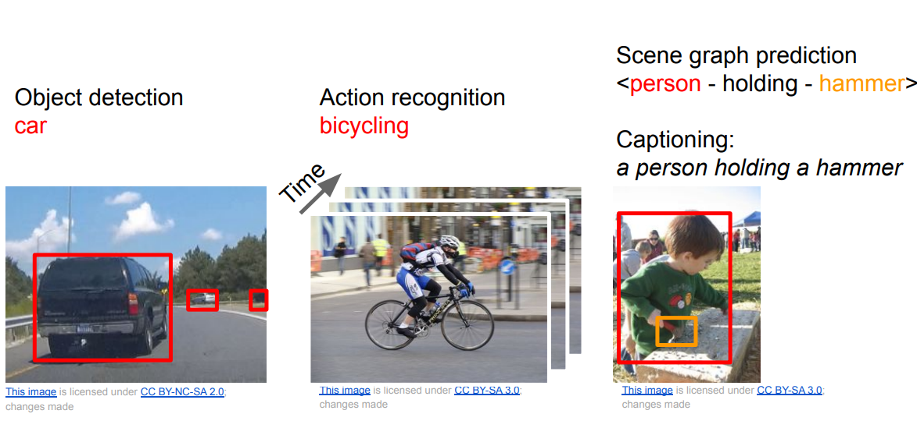

Slide 28
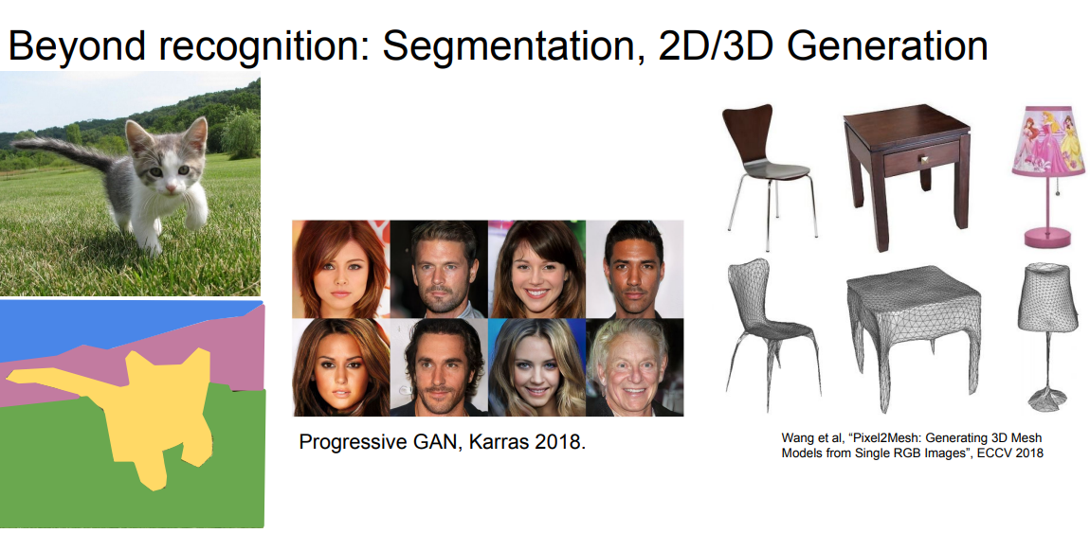

Slide 29
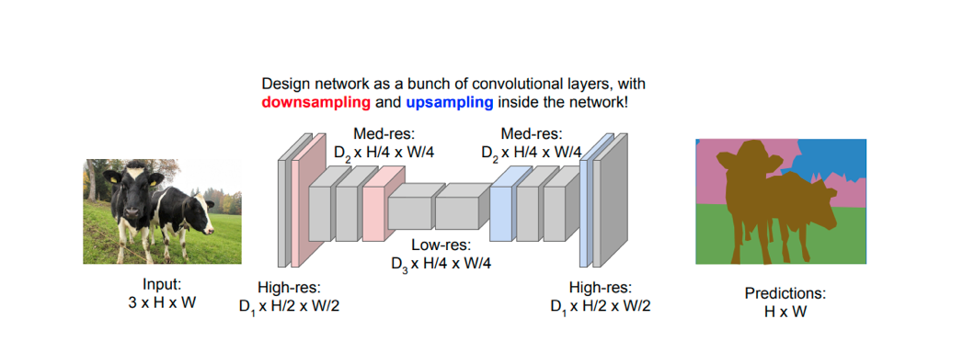
Semantic Segmentation
The goal of Semantic Segmentation is to label every single pixel of an image with a particular class. This is used in Autonomous driving!

Slide 30
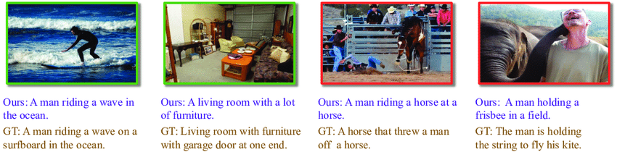
Image Captioning
Image captioning involves finding a “caption” that suits or describes a particular image, Microsoft COCO is the dataset that’s widely used.
Okay? But how do we go about this ?

Slide 31
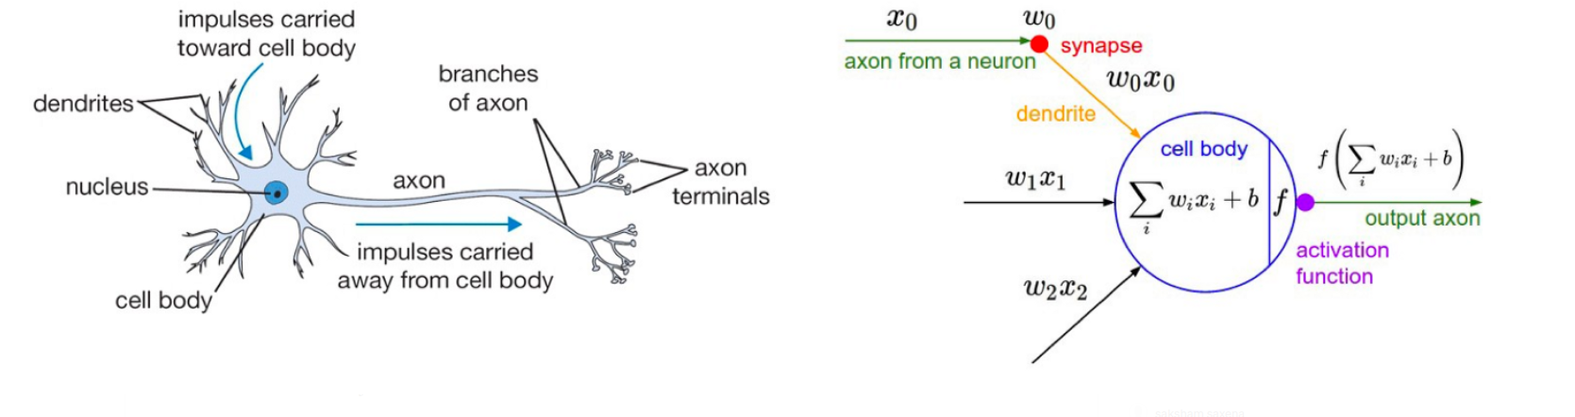
Neural Networks
You know the story, These Machine Learning Models were “inspired” from how the brain actually works. However we aren’t even close to actually achieving human performance yet.

Slide 32
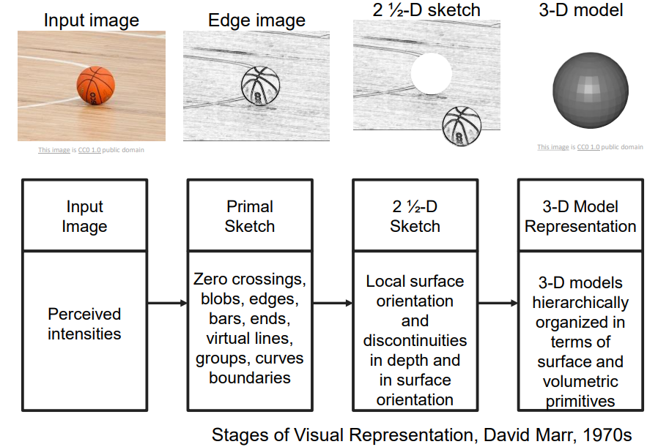

Slide 33
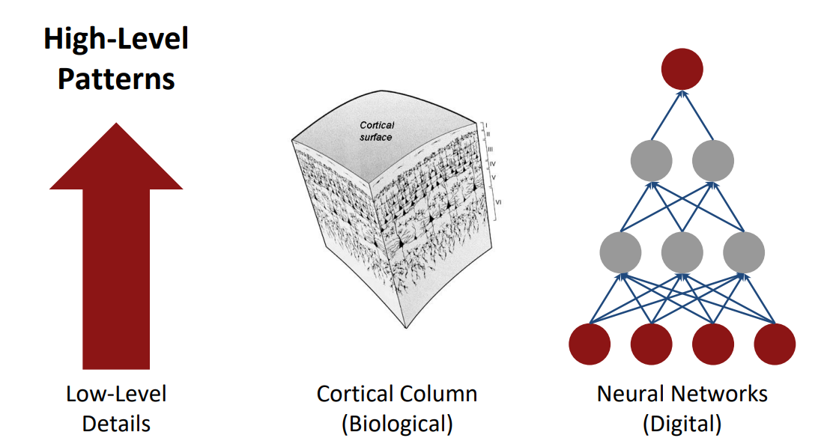

Slide 34
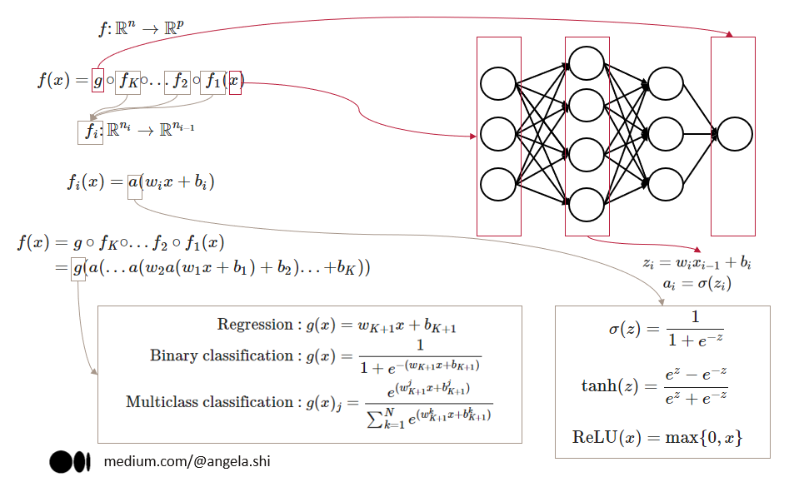
Structure of a Neural network

Slide 35
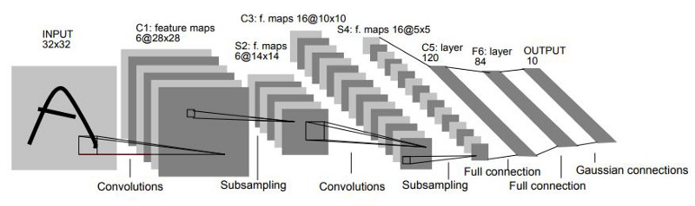
Convolutional Neural Networks
Sharing of parameters and the ability to learn deeper aspects of a particular image, like edges and even later, faces.

Slide 36
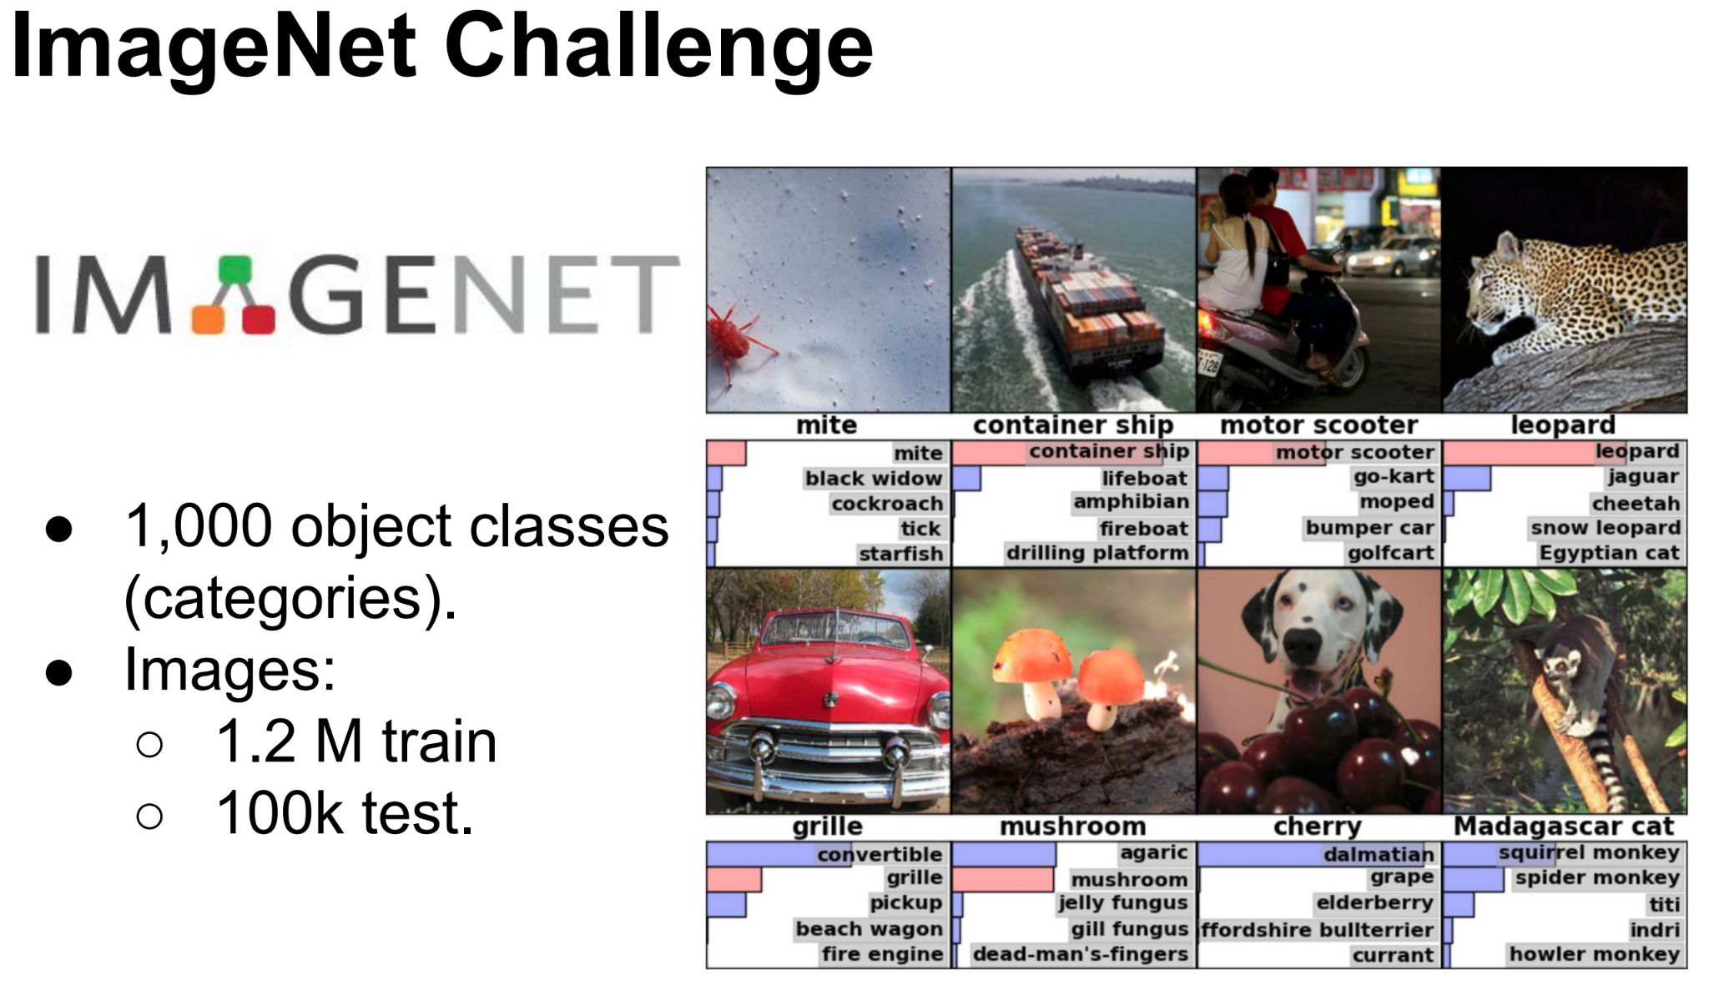
The ImageNet dataset

Slide 37
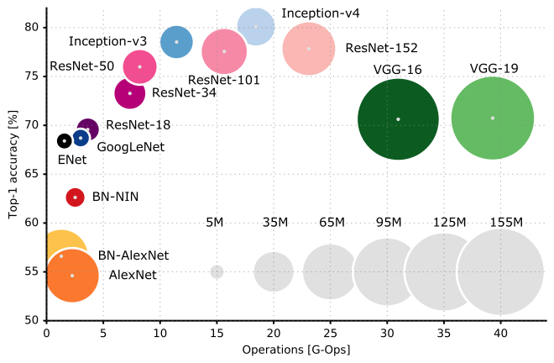
A few Different Model Names that fly around

Slide 38
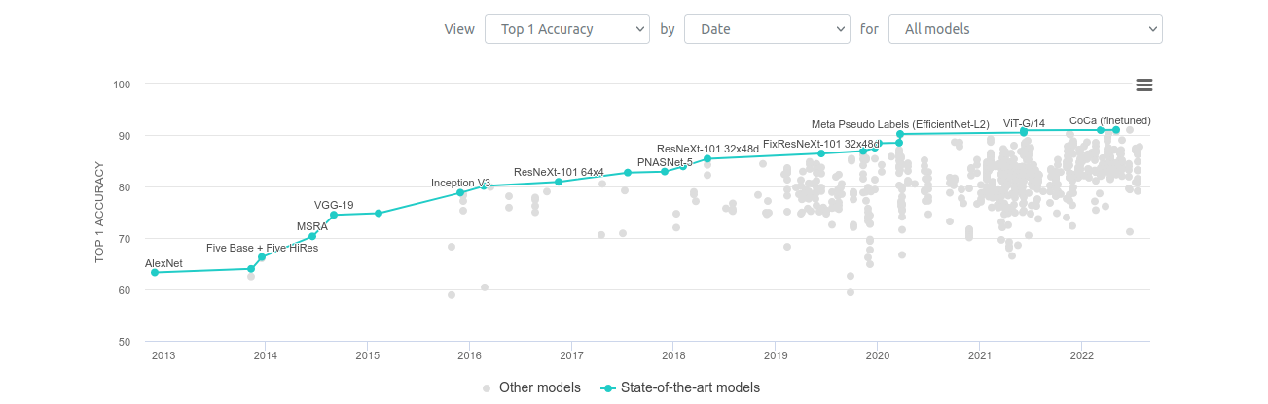
ImageNet Performance charts over a few years

Slide 39
Why was AlexNet so damn good!
The RELU non-linearity really became popular after the AlexNet paper.
GPU’s have the ability to perform computations in parallel with several cores,
Think about Matrix multiplication, things could speed if each row and column vector dot products happen simultaneously. This difference starts to become apparent. When the number of parameters become huge (Deep Neural Networks).
AlexNet had ~ 61M parameters ! : ()
It was nearly 4 times as fast compared to the CPU version.

Slide 40
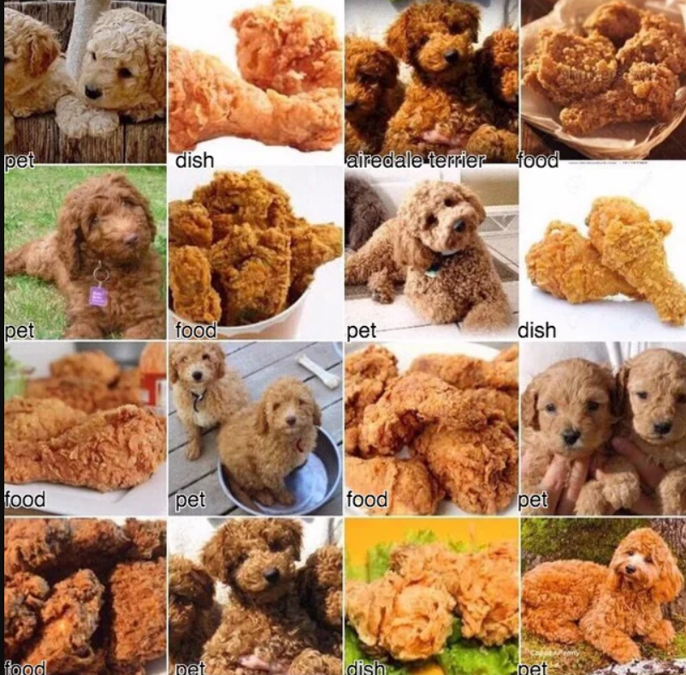
Well, What’s stopping us to improve more?

Slide 41

Recommender Systems

Slide 42
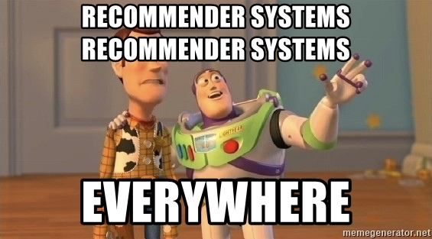
What are recommendation systems?
Recommendation system is an information filter which suggests/recommends products or features to users.
It helps users discover new products/content out of a huge corpus.
Examples
Youtube
Spotify
Goodreads
Amazon

Slide 43
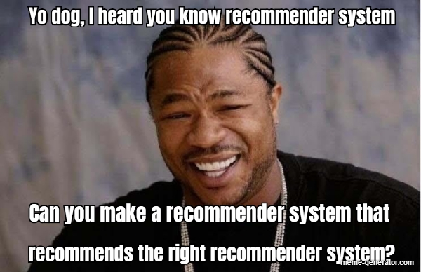


Use Cases
Personalized Content
E-Commerce/Retail
Banking/Finance

Slide 44
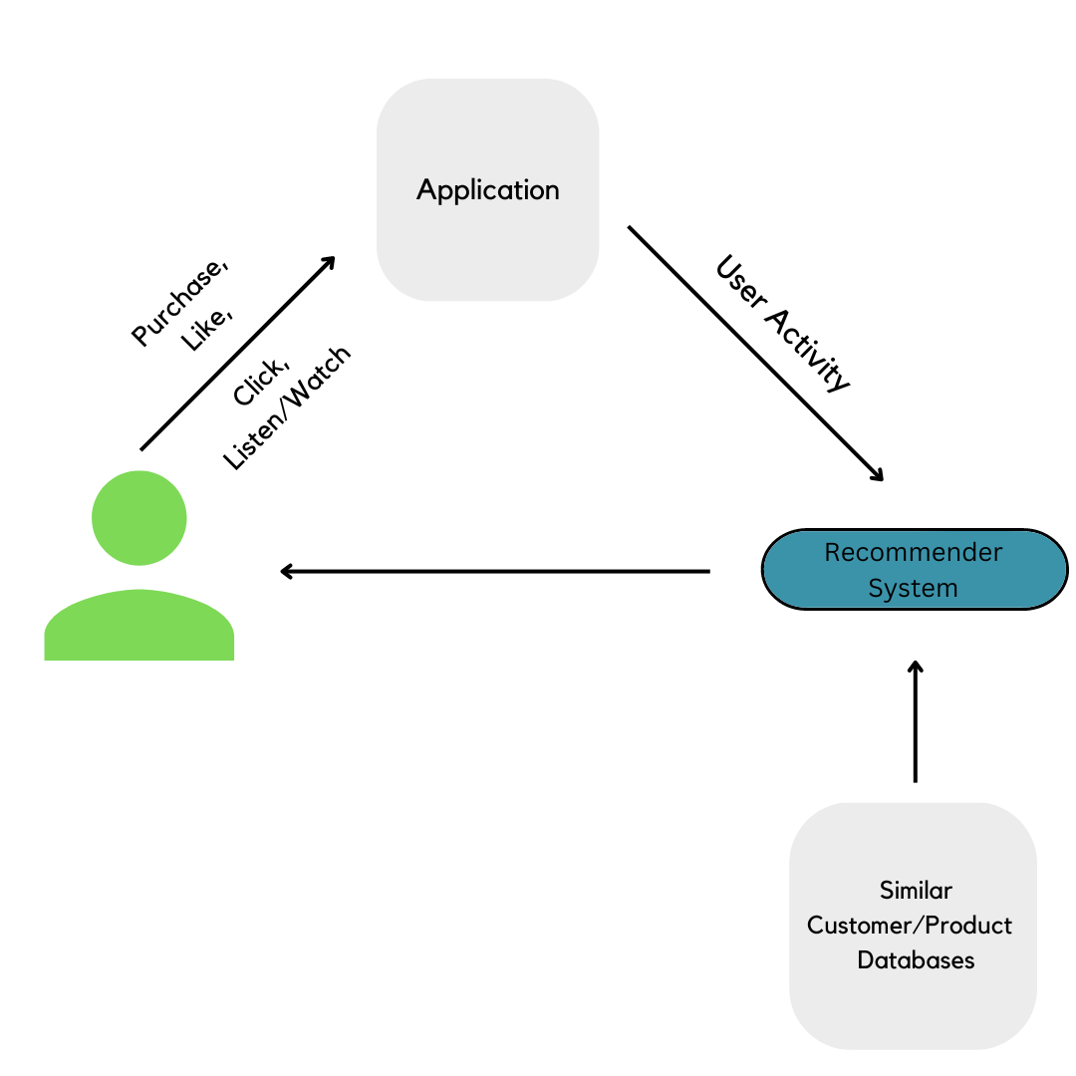
Flow of a Recommendation System

Slide 45
Terminology
Item - the entities/products/features a system recommends
Query - the info a system uses to make recommendations. This can include personal user behaviour such as browsing/consumption pattern and also some external factors such as the popularity of an item or seasonal trends.
Candidate Generation
Content Based Filtering
Collaborative Based FIltering

Slide 46
Content Based Filtering
It uses the features/characteristics of an item to recommend new products based upon the current user's preferences and items it has previously interacted with .
Similarity between user features and item features is found out. Suppose a song has features such as instrumentalness, acousticness etc., which has significant value and so does a user(calculated from methods which we won’t get into now), we would recommend the song to the user based on a similarity score.
Users and items need to have features in the same feature space for this method to work.
This method is not using any other user, it is just using the content of the items.

Slide 47
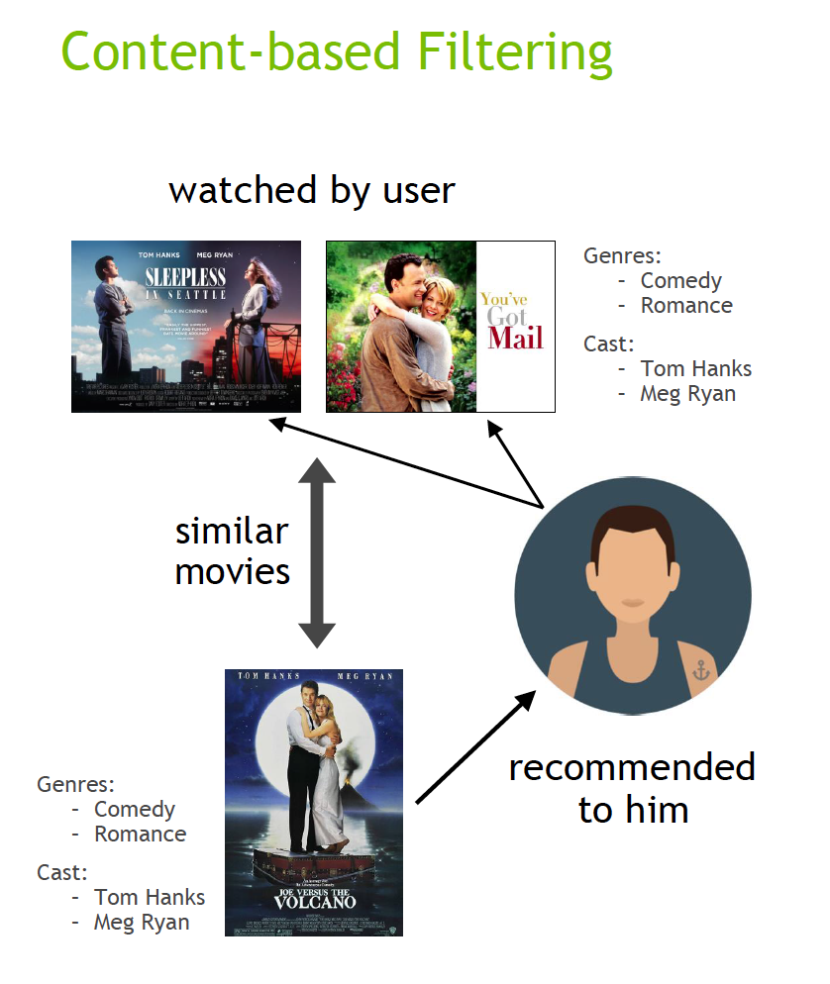
Content Based Filtering

Slide 48
Advantages:
- Data for other users is not needed.
- Helps recommend users items which are specific to their interest, whereas in collaborative filtering, other user's preferences do play a role in recommendation.
- May recommend obscure items as well.
Disadvantages:
- Model will be as good as the hand engineered features. This requires input from experienced and skilled domain experts.
- Works better for items that can be encoded with useful features.
- The model will have to represent the user based on their interest in the feature space, ie, they would have to extract the detailed feature for the user.

Slide 49
Collaborative Filtering
It recommends(filter) items from a huge corpus of items based upon the preference info from many users(collaboration). Putting forth a basic example, if two users have made similar decisions and purchases in the past, like a movie choice, then there is a high probability they will agree on additional future selections.
It uses similarities between items and users simultaneously.
It recommends/filters on behaviour and consumption pattern of users and its interaction with the items/products.
Personal tastes are correlated in this method.

Slide 50
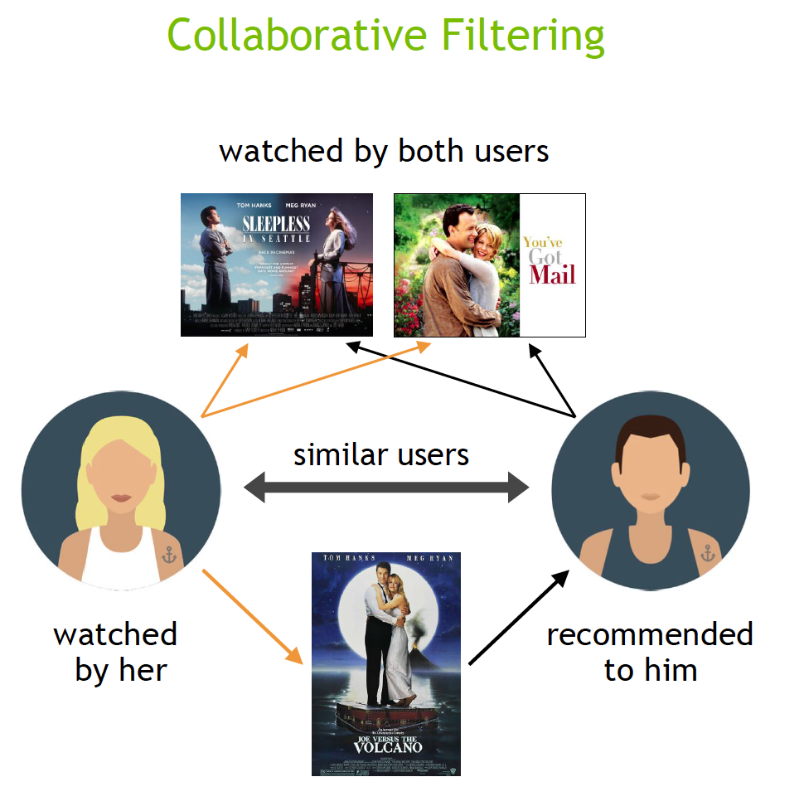
User Based Collaborative Filtering

Slide 51
Advantages -
Domain experts are not needed as features are not hand engineered.
Disadvantages -
Does not work on new items as they do not have user interactions.

Slide 52
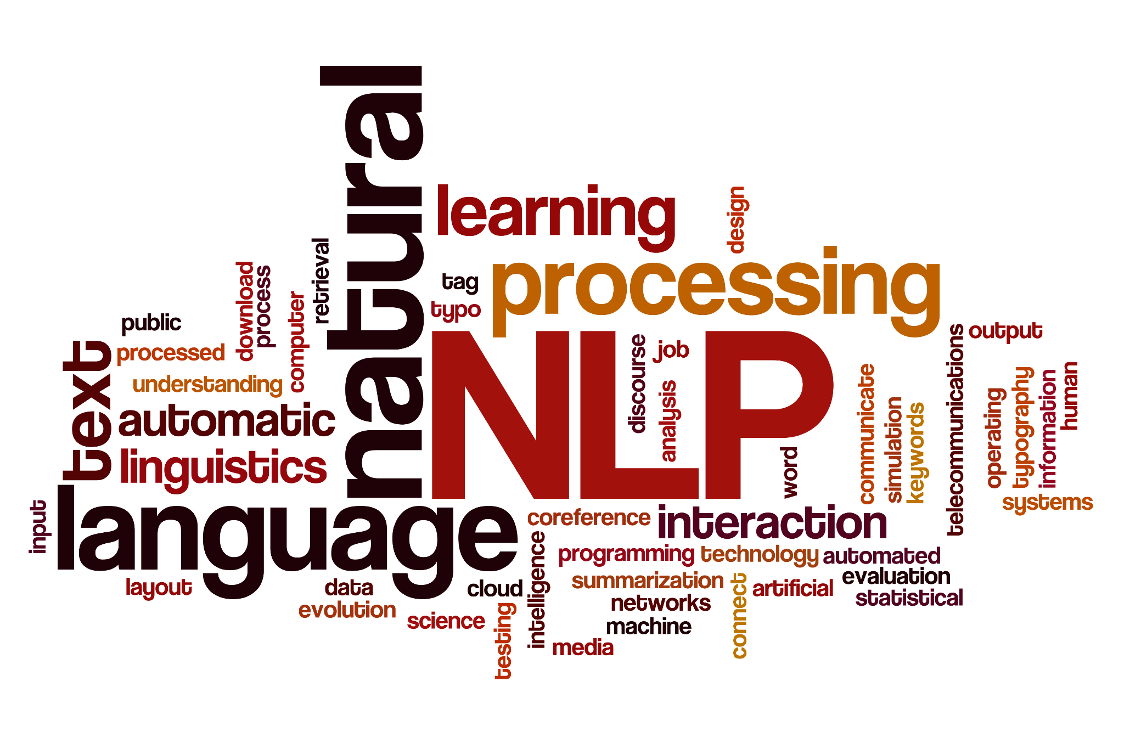

Slide 53
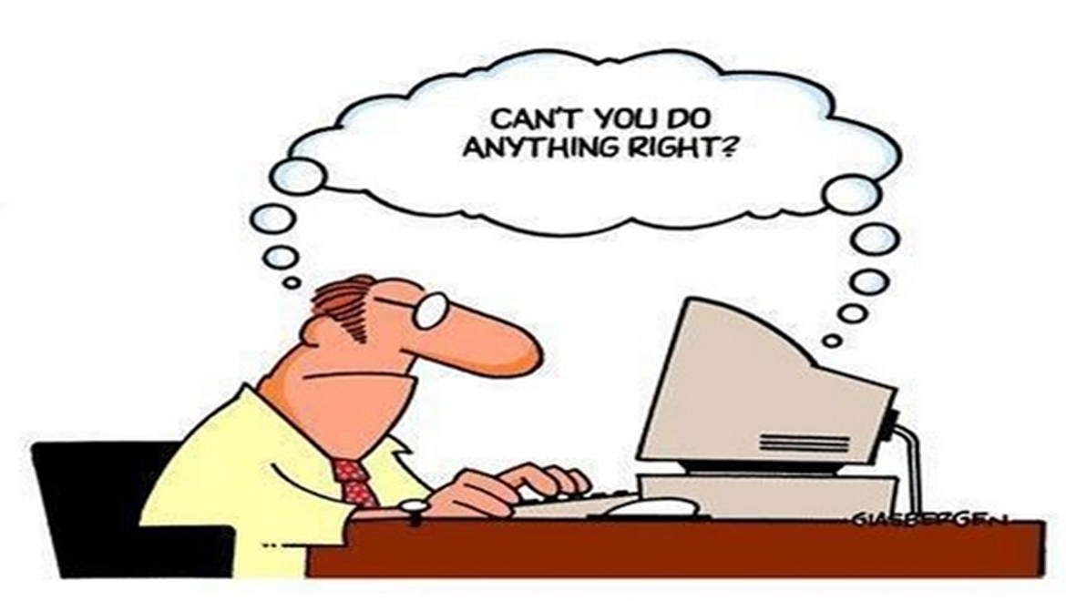
Natural Language Processing
NLP is an interdisciplinary field concerned with the interactions between computers and humans using natural human languages.

Slide 54
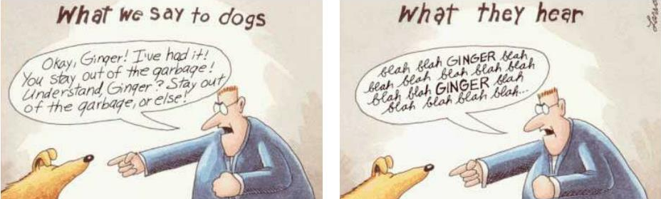
What is NLP?
Fundamental goal: deep understand of broad language Not just string processing or keyword matching!

Slide 55
NLP = Computer Science + AI + Computer Linguistics

Slide 56
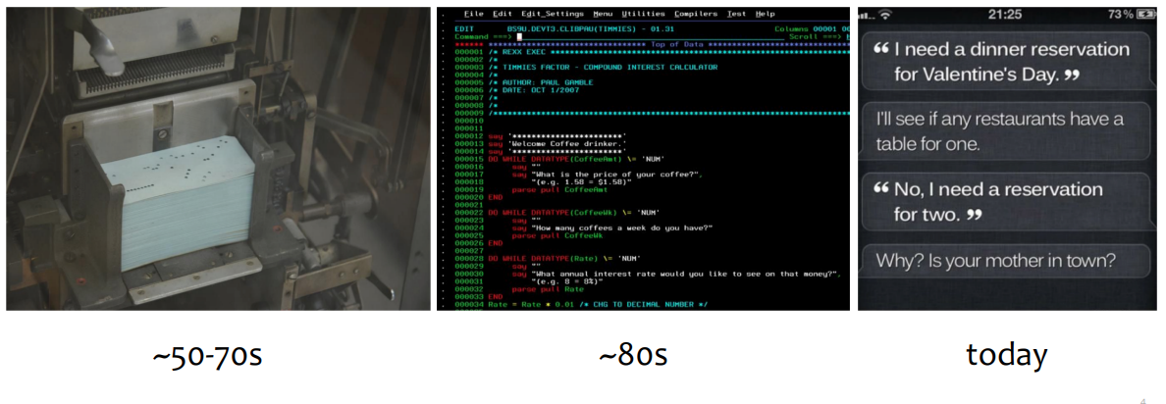
Communication With Machines

Slide 57
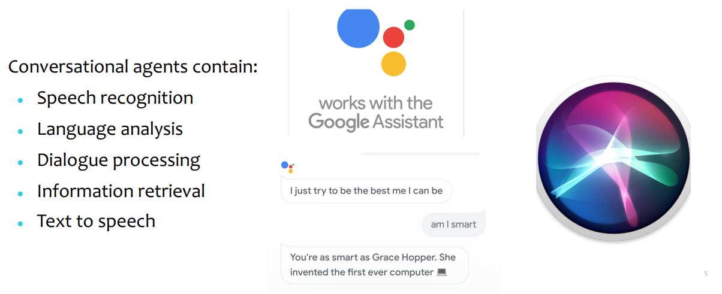
Conversational Agents

Slide 58
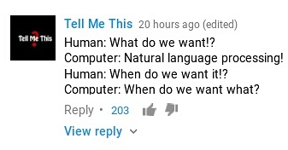

Slide 59
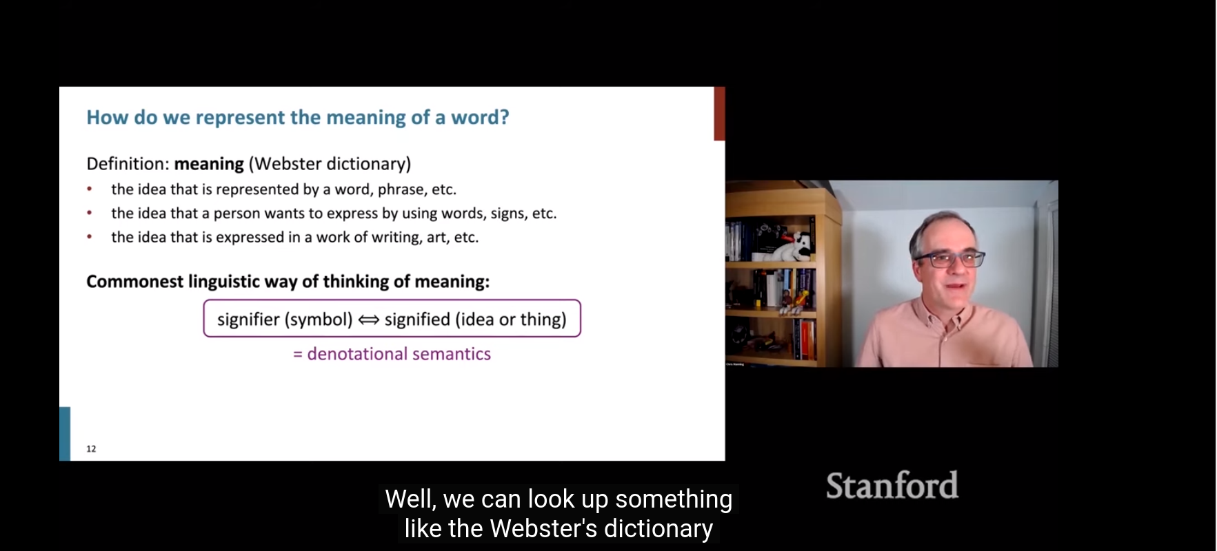
Speech to Text

Slide 60
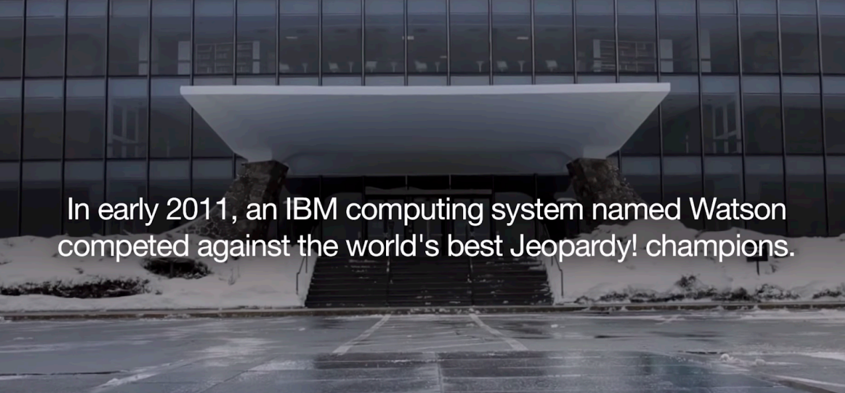

Slide 61
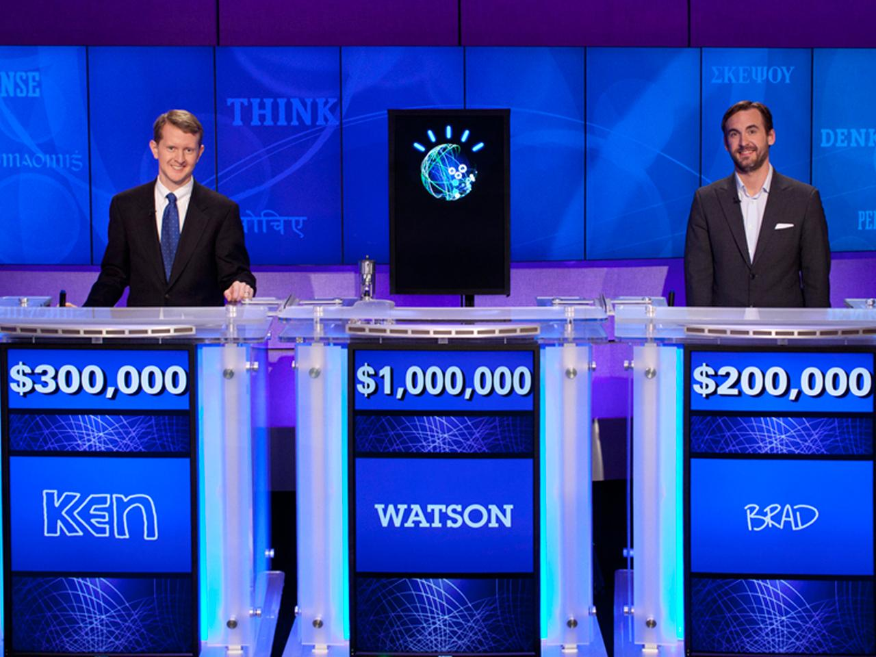
Question Answering
What does “divergent” mean?
What year was Abraham Lincoln born?
How many states were in the United States that year?
How much Chinese silk was exported to England in the end of the 18th century?
What do scientists think about the ethics of human cloning?

Slide 62
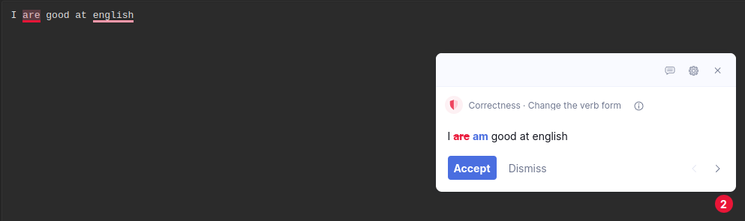
Spell Correction

Slide 63
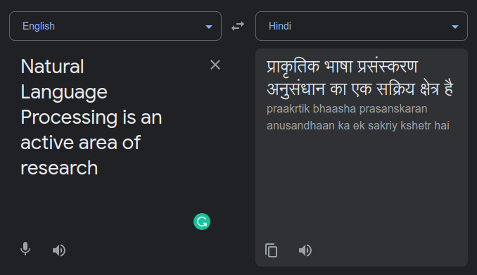
Machine Translation

Slide 64
Some more applications
Recommendation systems I.e. Netflix, YouTube
Search engines: google, bing, edge….
Social media monitoring
Image captioning
Text summarisation
Plagiarism check
AND LOT MORE………….

Slide 65
Demo Videos
Facebook Cyber Watchdog
Twitter Cyber Watchdog
References:
Overview of the hasoc subtrack at fire 2021: Conversational hate speech detection in code-mixed language Authors: Shrey Satapara, Sandip Modha, Thomas Mandl, Hiren Madhu, Prasenjit Majumder at FIRE 2021
Detecting and visualizing hate speech in social media: A cyber watchdog for surveillance Authors: Sandip Modha, Prasenjit Majumder, Thomas Mandl, Chintak Mandalia at ESWA
https://hasocfire.GitHub.io

Slide 66
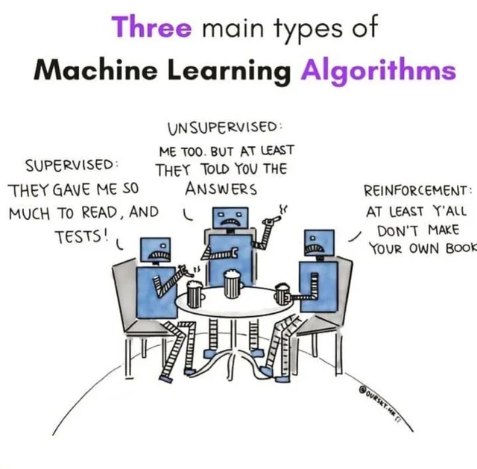
Reinforcement Learning

Slide 67
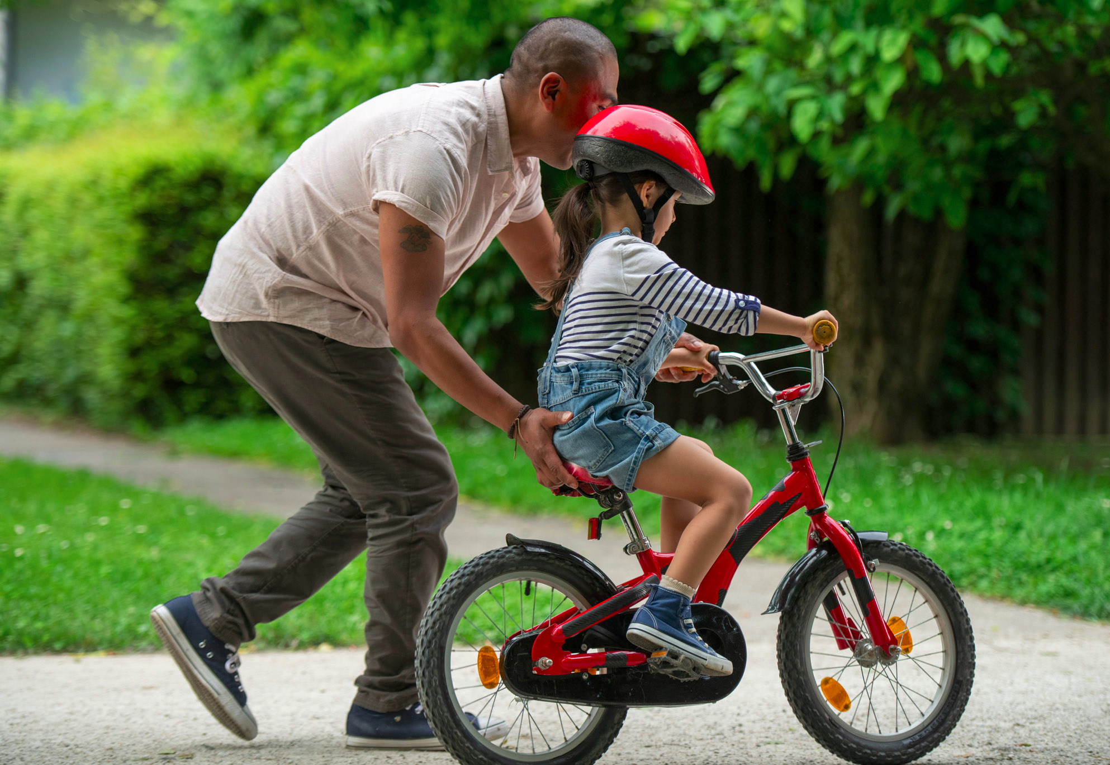
How did you learn to cycle
Notes:
Great example, often used by Balaraman Ravindran
Learning to cycle, is not an example of supervised learning
Not supervised learning either, because it would mean, that you watched hundreds of videos of people cycling and learnt inherent pattern and reproduced it
So this is distinct from supervised and unsupervised learning
Mathematical formalism for learning through reward and punishment/negative reward, etc

Slide 68
How did you learn to cycle
Not supervised learning

Slide 69
How did you learn to cycle
Not supervised learning
Not unsupervised learning

Slide 70
How did you learn to cycle
Not supervised learning
Not unsupervised learning
Learning by Trial & Error

Slide 71
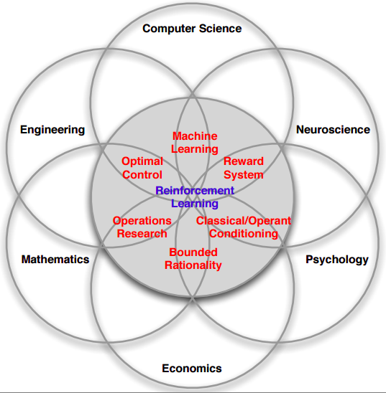
Notes:
Fundamentally - Science of decision making
Economics: Game theory, rational being, etc
Neuroscience and Psychology: Pavlov’s dog
Computer Science: Machine learning
Mathematics and Engineering: Control Theory

Slide 72

What is it?
Notes:
State: Are the observation that the agent receives, example: in chess how the pieces are placed, here all the information is known, whereas for blackjack state will only be the cards on the table
Environment:
Reward: win or lose
Action: for a maze, what direction will the robot go in
Agent: a robot, or person playing chess, etc

Slide 73
What is it?
A policy defines the learning agent’s way of behaving at a given time

Slide 74
What is it?
A policy defines the learning agent’s way of behaving at a given time
A reward signal defines the goal of a reinforcement learning problem

Slide 75
What is it?
A policy defines the learning agent’s way of behaving at a given time
A reward signal defines the goal of a reinforcement learning problem
A value function specifies what is good in the long run

Slide 76

Reinforcement learning: An Example

Slide 77

Courtesy: MIT 6.S091: Introduction to Deep Reinforcement Learning (Deep RL)

Slide 78


Slide 79


Slide 80


Slide 81


Slide 82


Slide 83
Conclusion
Important parameters

Slide 84
Conclusion
Important parameters
Environment

Slide 85
Conclusion
Important parameters
Environment
Reward

Slide 86

Applications
Notes:
This though is with a caveat,
the problems we face in the real world can be extremely complicated in many different ways and therefore a typical RL algorithm has no clue to solve
But breakthrough was found through the combination of deep learning and Reinforcement learning to get Deep Reinforcement Learning

Slide 87

Applications

Slide 88


doi:10.1038/nature14236

Slide 89

Alpha Zero & Alpha Go

Slide 90

Why is this important?
Notes:
https://www.quantamagazine.org/is-alphago-really-such-a-big-deal-20160329/
Transfer Learning, etc

Slide 91
Why is this important?
IBM Deep Blue vs Gary Kasparov
Notes:
Ultimately, the Deep Blue developers used two main ideas. The first was to build a function that incorporated lots of detailed chess knowledge to evaluate any given board position. The second was to use immense computing power to evaluate lots of possible positions, picking out the move that would force the best possible final board position.

Slide 92
Why is this important?
IBM Deep Blue vs Gary Kasparov
AlphaGo vs Lee Sedol. Is it any different?
Notes:
To begin, AlphaGo took 150,000 games played by good human players and used an artificial neural network to find patterns in those games. In particular, it learned to predict with high probability what move a human player would take in any given position. AlphaGo’s designers then improved the neural network by repeatedly playing it against earlier versions of itself, adjusting the network so it gradually improved its chance of winning.

Slide 93
Why is this important?
IBM Deep Blue vs Gary Kasparov
AlphaGo vs Lee Sedol. Is it any different?
Ability to replicate intuitive pattern recognition is a big deal
Notes:
In an earlier paper, the same organization that built AlphaGo — Google DeepMind — built a neural network that learned to play 49 classic Atari 2600 video games, in many cases reaching a level that human experts couldn’t match. The conservative approach to solving this problem with a computer would be in the style of Deep Blue: A human programmer would analyze each game and figure out detailed control strategies for playing it.

Slide 94
Recent Progress in ML
Computer Vision / Image Recognition
ImageNet, CNNs, Autonomous driving
Speech Recognition
Voice assistants
Language Models
GPT-3, PaLM
Game Playing / Deep Reinforcement Learning
AlphaGo, AlphaZero
Text-to-Image Models
Dall-E, ImaGen

Slide 95
How to approach Machine Learning?
Python/R and libraries like NumPy, SciPy, Matplotlib, Seaborn, Scikit-Learn, Pandas, TensorFlow, PyTorch
Mathematics for ML
Probability & Statistics - Random variables, Expectations, Distributions
Linear Algebra & Matrix Calculus - Gradients/Hessians, Eigenvalue/vector
Understand the internals of ML algorithms
Build ML applications to know which algorithms to use when
Can read some ML research papers
Some good resources are mentioned in the next slide.

Slide 96
Resources!
3b1b Series on Neural Network
CS229
CS244D
CS231N
CS224N
Pattern Recognition and Machine Learning: Bishop

Slide 97




Social Media
Follow our social media handles for regular updates
Instagram
Twitter
YouTube
WhatsApp

Slide 98
Any Questions or Suggestions?

Slide 99
Thank You!

